Slide 1
IMDb
Movie
Analysis

Slide 2
TABLE OF CONTENTS
01
02
Project
Description
Tasks
03
04
Approach &
Insights
Result
01
02
03
04

Slide 3
01
PROJECT DESCRIPTION
01

Slide 4
Project Description:
Data description: This project is done using IMDB_Movies dataset containing 28 features related to different aspects of 1 IMDb movie.
Expected Project Deliverables: i. Project report on the provided tasks. ii. Solving a problem after framing it

Slide 5
TASKS
02

Slide 6
Tasks
Data Cleaning
Find movies with highest profit
Find Top 250 IMDb movies
Top 10 directors (based on avg IMDb rating/score)
Find popular genres
Find critic favourite and audience favourite actors
Tech stack used: MS Office Excel 2007

Slide 7
Approach
& Insights
03
This section describes upon how the problems/tasks are solved and the results/insights from the tasks.

Slide 8
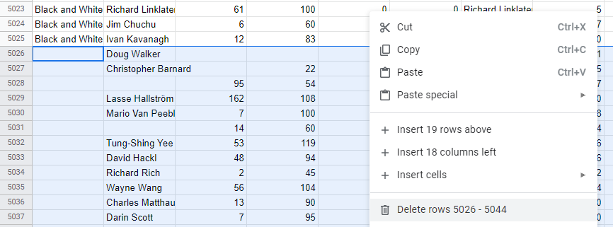
Data Cleaning
NULL VALUES:
To-Do: Delete each records where values are absent (in each column).
Approach:
I. Make a table: Select the dataset range and convert to table.
II. Group empty records together: Sort column A-Z OR Z-A.
III. Find empty records: Go to the bottom of the range.
IV. Select empty records: Select the empty records for the respective column.
V. Delete empty records: Right click the selected records and delete entire row.
VI. Loop: Repeat steps I-V for each column.

Slide 9
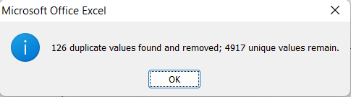
Data Cleaning
DUPLICATE/REDUNDANT VALUES:
To-Do: Edit the table for unique records only.
Approach:
> Go to the Data tab.
> Click remove duplicates button.
> Check the movie_title box.
> Click OK.
> Following dialogue box appears

Slide 10
2. Movies with highest profit (Approach)
Create new column:
Go to 1 column after the extreme right column(in first row).
Enter ‘Profit’ as a header.
Enter formula: under the ‘Profit’ cell type the following text in red =I2-W2
where = : to initiate a formula
I2 : 1st record of Gross(movie earning),
W2 : 1st record of Budget
Copy formula to entire column:
Double click at the bottom right of the formula applied cell to copy down the formula to the entire column.

Slide 11
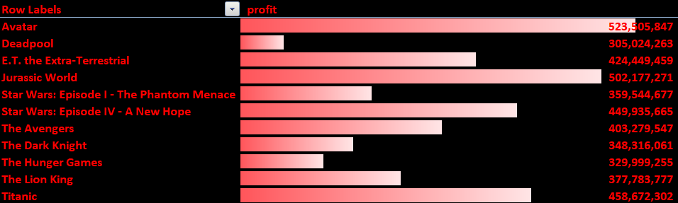
2. Movies with highest profit (Insights)
* Link to the full list of movies with highest profit.

Slide 12
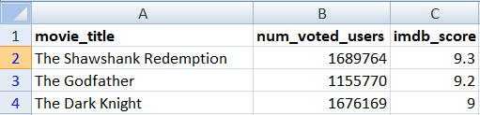

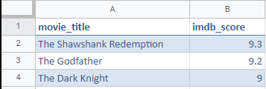
3. IMDb Top 250 (Approach)
Make new worksheet with existing records of:
i. Movie_title (A)
ii. Num_voted_users (B)
iii. Imdb_score (C)
Insert two new empty columns namely:
i. Movie_title
ii. Imdb_score
Enter formula under the empty records:
=IF(B2>25000,A2) for movie_title
=IF(B2>25000,C2) for imdb_score

Slide 13
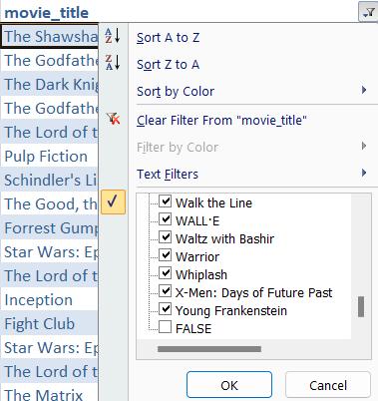


3. IMDb Top 250 (Approach)
In the text filters, uncheck FALSE text under movie_title.

Slide 14
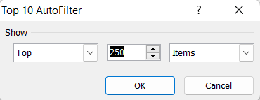
3. IMDb Top 250 (Approach)
Apply a number filter of Top 10, edit it to Top 250 for imdb_score column.
The above filter ensures there’s only movies with num_voted_users>25000 in the range.
Put a rank column next to the extreme right for S.No.

Slide 15
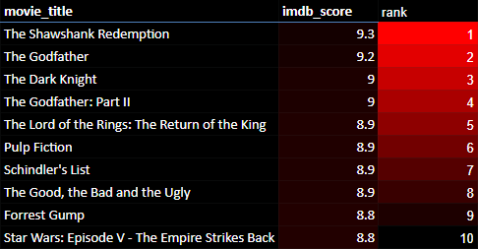
Insights
*view full list here

Slide 16
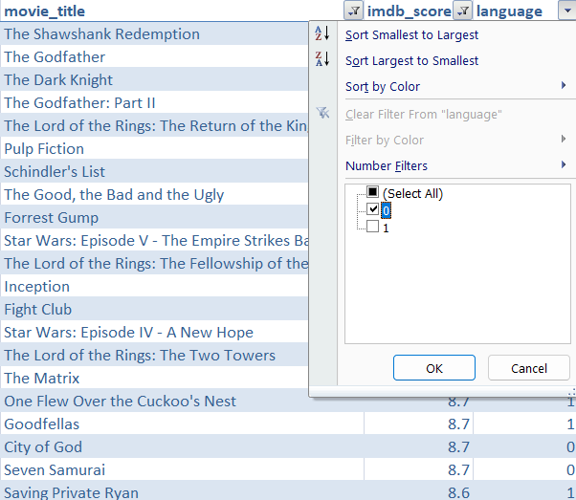
3. Top Movies in languages other than english
Approach:
Add a third column “language” to the top 250 movies table.
Enter the following formula under the language column
=IF(AND(Table1[[#This Row],[movie_title]]='working data'!$L$2:$L$3790,'top 250 movies'!$D$2:$D$266="English"),1,0)
to output a binary value for the movie language if English.
Apply filter to language column and deselect 1 to edit the data frame for movies other than English only.

Slide 17
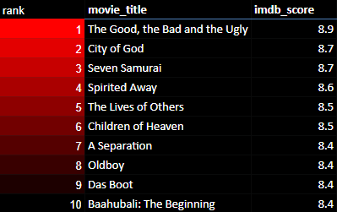
3. Top Movies in languages other than english
INSIGHTS
*view full list here

Slide 18
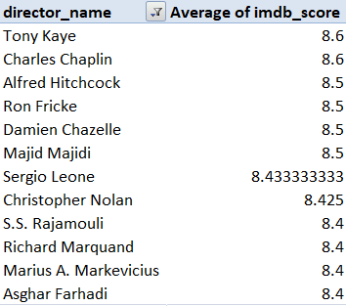
4. Top 10 Directors (Approach)
Create pivot table:
> Insert pivot table to the data range.
Add row labels:
> Drage director_name to row labels under field list.
Add a value column:
> Drag imdb_score to values field under field list.
> Select average of values in value field settings.
Sorting:
> Sort the imdb_score column Z-A/descending.
Value filter:
> Apply value filter to movie_title.
> Select Top 10, click OK.
Insights

Slide 19
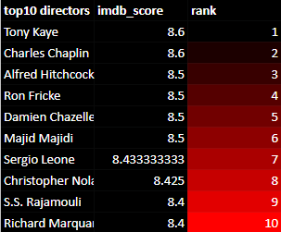
4. Top 10 Directors (Approach)
Insights
Convert pivot table to a table.
Custom sort the data in the following order:
I. imdb_score by descending order.
II. director_name by ascending order.
Add a rank column to extreme right:
Enter ‘1,2’ to first two columns and 2x click on bottom right of the cell to copy sequence.
Apply Top10 filter to the table.

Slide 20
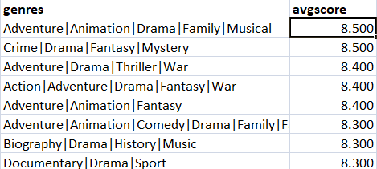
5. Popular genres(Approach)
Get the name of all the distinct genre records:
On the genre column, apply the advanced filter and select unique records only.
Use the AVERAGEIF function to get the average imdb_score of each genre:
=AVERAGEIF(Table2[genres],D2,Table2[imdb_score])
Copy the formula to each cell and then sort the avgscore column by Z-A.

Slide 21
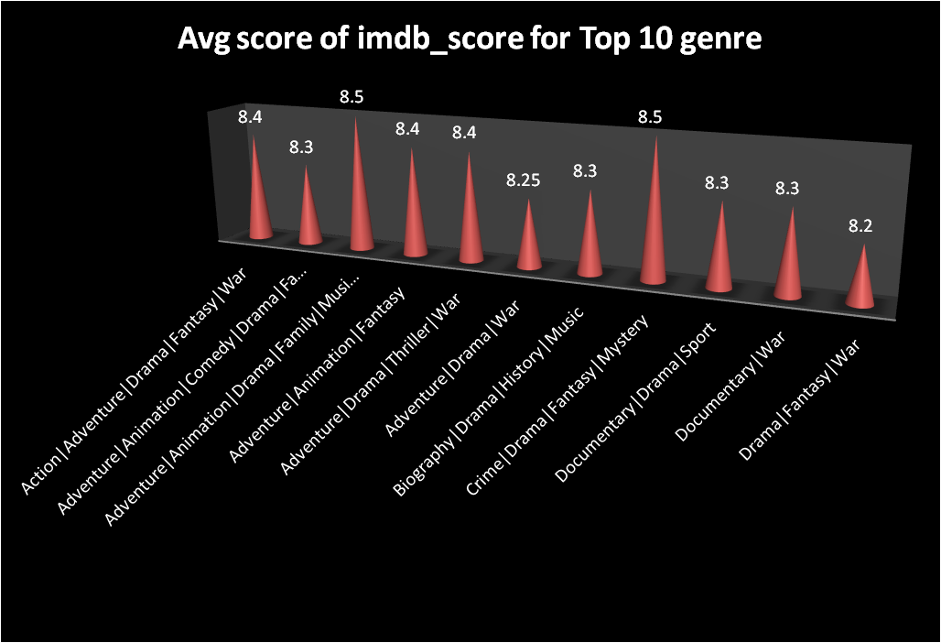
5. Popular genres(Insights)
popular genres

Slide 22
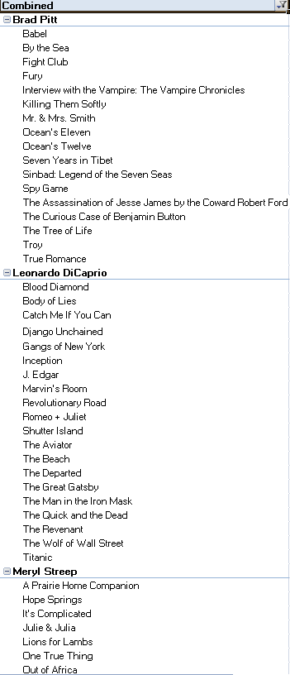
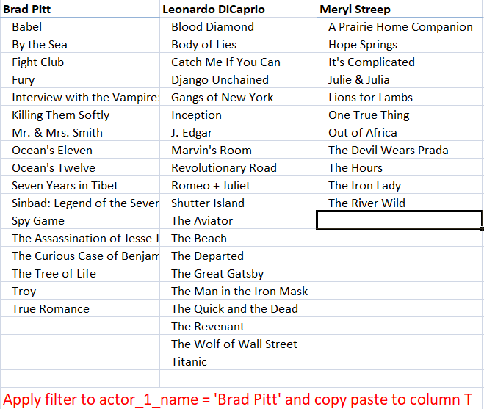
6. Favourite actors

Slide 23
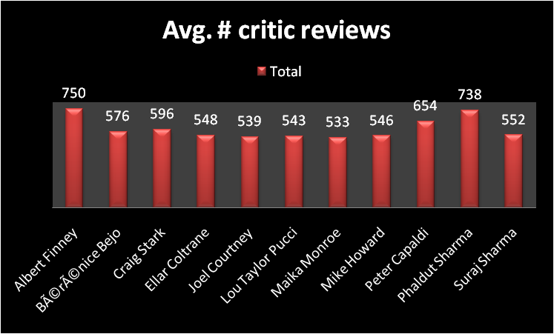
6. Critic-Favourite actors (mean of critic reviews)
Create pivot table:
On columns:
actor_1_name
Average of num_crtitc_reviews
Create pivot chart:
On pivot table for first 10 rows.
*Click to view the full table.

Slide 24
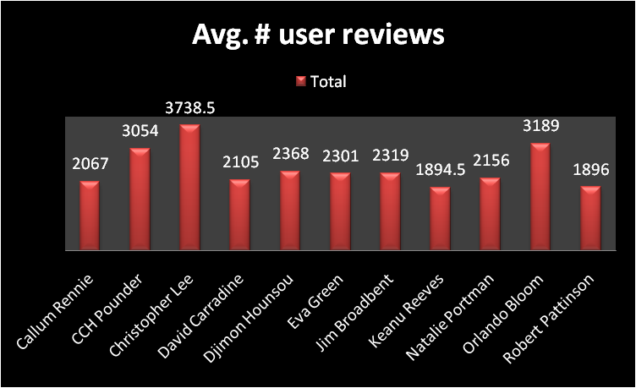
6. Audience-Favourite actors (mean of user reviews)
Create pivot table:
On columns:
actor_1_name
Average of num_user_for_reviews
Create pivot chart:
On pivot table for first 10 rows.
*Click to view the full table.

Slide 25
Timeline analysis (number of voted users)
Columns used: title_year, num_voted_users.
Convert into pivot tables.
Group the title_year column by 10 to group the column by decade.
Make a line pivot chart of the following table.
Check the following link for the insights:
number of voted users (timeline analysis)

Slide 26
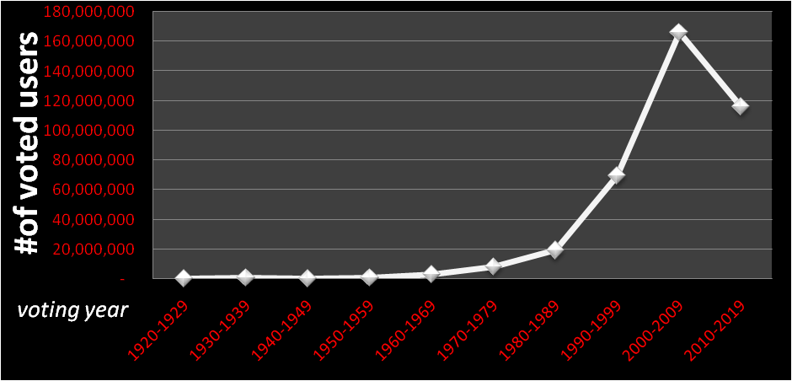
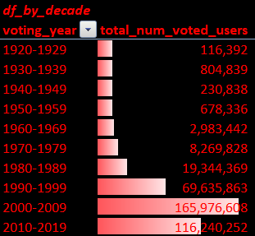
Timeline analysis (number of voted users by decade)
Line chart analysis
Bar chart analysis

Slide 27
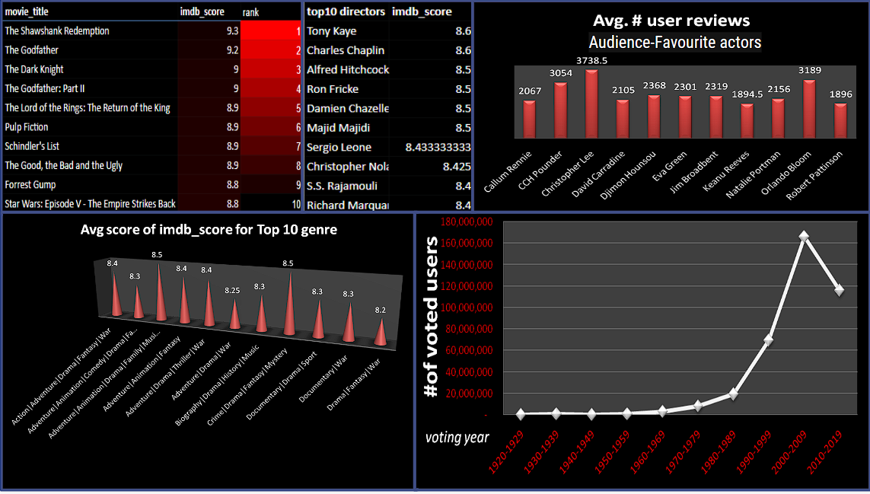
KPIs
DASH BOARD

Slide 28
Audience-Favourite actors

Slide 29
RE
SULT
04

Slide 30
In conclusion, this project involved performing various data cleaning and analysis tasks on a movie dataset using Excel. The data was cleaned by dropping columns and removing null values. The movies with the highest profit were identified by creating a new column called profit and plotting profit vs budget to observe outliers. The top 250 movies were selected based on their IMDb rating and num_voted_users criteria and a new column was created for non-English movies called Top_Foreign_Lang_Film.
The best directors were identified by grouping the data by director_name and finding the top 10 directors with the highest mean IMDb score. The popular genres were also identified using the knowledge gained from the previous steps. The actors Meryl Streep, Leonardo DiCaprio, and Brad Pitt were extracted from the data and a new column was created called Combined. The actors were grouped and the mean of num_critic_for_reviews and num_users_for_review was calculated to identify the critic-favorite and audience-favorite actors.
Finally, a bar chart was created to observe the change in number of voted users over decades by creating a new column called decade and grouping the data by decade. The sum of users voted in each decade was calculated and stored in a new data frame called df_by_decade. Overall, the project successfully demonstrated various data cleaning and analysis techniques in Excel to gain insights into the movie dataset.

Slide 31
Drive link:
IMDB movie analysis

